Slide 1
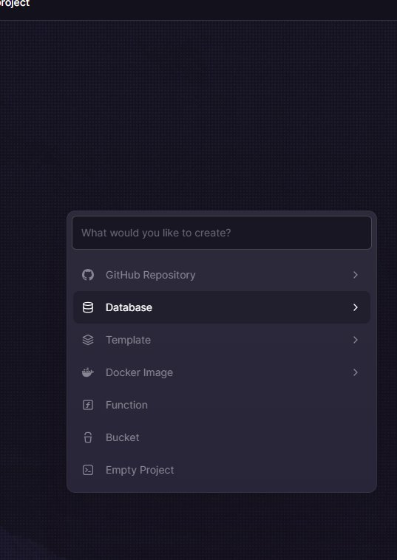
EN
WEEK 01
</>
ML Mindset & the 5-Step Workflow
How machine learning works and how to approach any ML problem
By the end of this lesson you will be able to:
○ Explain the difference between AI, ML and traditional programming
○ Describe supervised vs unsupervised learning with real examples
○ Apply the 5-step ML workflow to any new problem
codencode.my
ML Fundamentals • Week 01 — ML Mindset & the 5-Step Workflow
EN
01

Slide 2
AI vs ML vs Deep Learning
AI
Artificial Intelligence
ML
Machine Learning
The broad goal: build machines that perform tasks requiring human intelligence. AI is the umbrella term — the dream.
A subset of AI. Instead of coding rules manually, we feed data and let the machine learn patterns automatically.
DL
Deep Learning
DS
Data Science
A subset of ML using neural networks with many layers. Powers image recognition, ChatGPT, voice assistants.
Uses statistics, ML and programming to extract insights from data. Overlaps heavily with ML in practice.
codencode.my
ML Fundamentals • Week 01 — ML Mindset & the 5-Step Workflow
EN
02

Slide 3
Types of Machine Learning
📖 How machines learn
ml_types.py
There are 3 main learning styles:
🏷️ Supervised Learning
You give labelled examples. Model learns input→output.
Examples: spam filter, price prediction, diagnosis
🔍 Unsupervised Learning
No labels. Model finds hidden patterns itself.
Examples: customer segments, anomaly detection
🎮 Reinforcement Learning
Agent takes actions, gets rewards/penalties.
Examples: game AI (AlphaGo), robotics, self-driving
# Supervised — predicting house price
# Input: [size, bedrooms, location]
# Output: price (you provide examples)
# Unsupervised — grouping customers
# Input: [age, spend, frequency]
# Output: cluster labels (no labels given)
# Reinforcement — game agent
# State: game board position
# Action: move left / right / jump
# Reward: +1 for score, -1 for death
# Most practical ML is supervised learning
# (classification and regression)
codencode.my
ML Fundamentals • Week 01 — ML Mindset & the 5-Step Workflow
EN
03

Slide 4
The ML Workflow — 6 Steps
ml_workflow.py
# Step 1: Define the problem
# "Predict if a student will pass"
# Step 2: Collect data
# study_hours = [1, 2, 3, 4, 5, 6, 7, 8]
# passed = [0, 0, 0, 1, 1, 1, 1, 1]
# Step 3: Prepare data (clean, split)
# X_train, X_test, y_train, y_test = split(data)
# Step 4: Choose and train model
# model = LogisticRegression()
# model.fit(X_train, y_train)
# Step 5: Evaluate
# accuracy = model.score(X_test, y_test)
# Step 6: Predict on new data
# model.predict([[5.5]]) # → [1] = PASS
# This 6-step process applies to ALL ML projects
💡 What this does:
Every ML project follows this same pipeline. This week we understand the big picture — from week 2 onwards we implement each step in Python.
codencode.my
ML Fundamentals • Week 01 — ML Mindset & the 5-Step Workflow
EN
04

Slide 5
ML in the Real World
📖 Applications you already use
ml_examples.py
ML is already part of your daily life:
📱 Your phone:
○ Face ID → face recognition (DL)
○ Siri/Google → speech recognition (DL)
○ Photo categorisation → image classification
🛒 Shopping & streaming:
○ "Recommended for you" → collaborative filtering
○ Spam filter → text classification
○ Fraud detection → anomaly detection
🏥 High-stakes applications:
○ Cancer detection from X-rays
○ Autonomous vehicles
○ Financial risk scoring
# Simple spam detector concept
emails = [
("Win a free prize now!!!", "spam"),
("Meeting at 3pm tomorrow", "not spam"),
("CLICK HERE to claim reward", "spam"),
("Your assignment feedback", "not spam"),
]
# The ML model learns:
# "free","win","click" → spam
# "meeting","assignment" → not spam
# After training on thousands of examples,
# it classifies new emails automatically.
# This is supervised text classification —
# one of the most common ML tasks.
codencode.my
ML Fundamentals • Week 01 — ML Mindset & the 5-Step Workflow
EN
05

Slide 6
Key ML Vocabulary
feat
Features (X)
labl
Labels (y)
The input variables fed to the model. Also called attributes or predictors. Example: [age, salary, study_hours].
The output we're trying to predict. Also called target variable. Example: passed/failed, price, spam/not spam.
train
Training
test
Testing
Fitting the model on labelled data so it learns the relationship between features and labels. The model 'sees' this data.
Evaluating on data the model has never seen — the only honest way to know if your model actually generalises.
codencode.my
ML Fundamentals • Week 01 — ML Mindset & the 5-Step Workflow
EN
06

Slide 7
Classification vs Regression
📖 Two flavours of supervised learning
reg_vs_class.py
Supervised learning splits into two main types based on what you're predicting:
📊 Regression — predicting a continuous number
○ House price: RM 450,000
○ Temperature: 32.5°C
○ Exam score: 87.3
🏷️ Classification — predicting a category
○ Spam or not spam?
○ Disease: positive or negative?
○ Digit: 0 through 9?
Choosing the right type is your first decision in every ML project.
from sklearn.linear_model import LinearRegression
from sklearn.linear_model import LogisticRegression
# Regression — predicts a number
reg_model = LinearRegression()
# reg_model.fit(X, y_continuous)
# reg_model.predict([[5]]) → [85.3]
# Classification — predicts a class
clf_model = LogisticRegression()
# clf_model.fit(X, y_labels)
# clf_model.predict([[5]]) → ['pass']
# Output type tells you which to use:
# Number → Regression
# Category → Classification
codencode.my
ML Fundamentals • Week 01 — ML Mindset & the 5-Step Workflow
EN
07

Slide 8
🧠 Quiz Time!
Q:
A music app learns your preferences and recommends songs — without you ever labelling what you like. Which type of ML is this?
A
Supervised Learning — because it needs your listening history as input
B
Unsupervised Learning — it finds patterns in behaviour without labels
C
Reinforcement Learning — the app gets rewarded when you listen
D
Deep Learning — because it uses a neural network
codencode.my
ML Fundamentals • Week 01 — ML Mindset & the 5-Step Workflow
EN
08

Slide 9
Setting Up Your ML Environment
📖 Tools we'll use this course
setup_test.py
This course uses Python with the standard data science stack.
Core libraries:
○ NumPy — fast numerical arrays
○ Pandas — data tables (DataFrames)
○ Matplotlib — charts and visualisations
○ Scikit-learn — ML algorithms
○ Keras/TF — neural networks (Week 8)
Install everything at once:
pip install numpy pandas matplotlib scikit-learn
We'll use Jupyter Notebook or VS Code. Test your setup with the code on the right.
import numpy as np
import pandas as pd
import matplotlib.pyplot as plt
from sklearn.linear_model import LogisticRegression
print("NumPy:", np.__version__)
print("Pandas:", pd.__version__)
# Quick sanity check
arr = np.array([1, 2, 3, 4, 5])
print("Mean:", arr.mean()) # 3.0
print("Std:", arr.std()) # 1.414
# If this runs without errors
# your environment is ready! ✅
codencode.my
ML Fundamentals • Week 01 — ML Mindset & the 5-Step Workflow
EN
09

Slide 10
Your First ML Model — 10 Lines
first_model.py
from sklearn.linear_model import LinearRegression
import numpy as np
# Study hours (features) and scores (labels)
X = np.array([[1],[2],[3],[4],[5],[6],[7],[8]])
y = np.array([35, 42, 55, 65, 72, 80, 88, 93])
# Train the model
model = LinearRegression()
model.fit(X, y)
# Make predictions
hours = np.array([[5.5], [9]])
predictions = model.predict(hours)
print(f"5.5 hours → {predictions[0]:.1f}") # ~76.2
print(f"9.0 hours → {predictions[1]:.1f}") # ~95.8
# Model learned: score ≈ 8.6 × hours + 27.5
💡 What this does:
This is a complete ML model in 10 lines. LinearRegression finds the best-fit line through the data. fit() trains it; predict() uses it. You've just built ML.
codencode.my
ML Fundamentals • Week 01 — ML Mindset & the 5-Step Workflow
EN
10

Slide 11
Understanding Overfitting & Underfitting
fit_concepts.py
# Underfitting — model too simple
# (high training error, high test error)
# The line doesn't capture the pattern
# Good fit — just right
# (low training error, low test error)
# Model generalises to new data
# Overfitting — model too complex
# (very low training error, HIGH test error)
# Model memorised training data, can't generalise
# How to detect:
# - Train accuracy >> Test accuracy → overfit
# - Both accuracies low → underfit
# Solutions:
# Overfitting: get more data, simplify model,
# regularisation, cross-validation
# Underfitting: use more complex model,
# add more features
print("Rule of thumb:")
print("Training acc >> Test acc → OVERFIT")
print("Both low → UNDERFIT")
💡 What this does:
Overfitting and underfitting are the two fundamental problems in ML. Every technique you learn this course is ultimately about finding the right balance.
codencode.my
ML Fundamentals • Week 01 — ML Mindset & the 5-Step Workflow
EN
11

Slide 12
The ML Landscape — What's Coming
W2-4
Data Foundation
W5-6
Core Algorithms
NumPy arrays, Pandas DataFrames, and Matplotlib/Seaborn visualisations. 70% of ML work is data preparation.
Linear Regression, Logistic Regression, Decision Trees, Random Forests, SVM — the most widely used ML models.
W7
Model Evaluation
W8-9
Neural Networks
Accuracy, precision, recall, F1, ROC curves, cross-validation and hyperparameter tuning — how to know if your model is good.
Keras, dense layers, CNNs — the foundation of deep learning. Used for image, text and sequential data problems.
codencode.my
ML Fundamentals • Week 01 — ML Mindset & the 5-Step Workflow
EN
12

Slide 13
⌨️ Try It Yourself
📋 ML Concept Map + Environment Setup
🏆 XP Reward
1. Install numpy, pandas, matplotlib, scikit-learn using pip
2. Run the setup_test.py code and confirm all libraries import successfully
3. Run the first_model.py code — predict a score for 10 study hours
4. Draw a concept map: AI → ML → Deep Learning, with 2 real examples each
5. Find 1 real-world ML application and identify: what are the features? what is the label?
6. Bonus: Read about one famous ML dataset (Iris, Titanic, MNIST) and describe it in 3 sentences
50 XP
⏱ Time Limit
25 min
Expected output:
NumPy: 1.x.x
Pandas: 2.x.x ✅
10 hours → ~113 score
Concept map drawn
codencode.my
ML Fundamentals • Week 01 — ML Mindset & the 5-Step Workflow
EN
13

Slide 14
⌨️ Try It Yourself
📋 Classification vs Regression — Identify Each
🏆 XP Reward
1. For each scenario, write: Regression or Classification, and why
2. Scenario A: Predict tomorrow's temperature in Johor Bahru
3. Scenario B: Detect whether a bank transaction is fraudulent
4. Scenario C: Estimate the price of a used car given age and mileage
5. Scenario D: Classify a skin lesion photo as benign or malignant
6. Bonus: Think of 2 ML applications in Malaysia — classify each as supervised/unsupervised
30 XP
⏱ Time Limit
15 min
Expected output:
A: Regression (continuous temp)
B: Classification (fraud/not)
C: Regression (continuous price)
D: Classification (2 categories)
codencode.my
ML Fundamentals • Week 01 — ML Mindset & the 5-Step Workflow
EN
14

Slide 15
Lesson Summary
✅ What we learned today
🔍 Next Week
○ AI is the goal; ML is the method; Deep Learning is a powerful technique
Week 2: NumPy for Data Science
We'll master NumPy arrays — the foundation of all ML in Python. Fast, powerful, and essential for every calculation.
○ Supervised: labelled data → predict output. Unsupervised: find patterns without labels
○ Regression predicts numbers; Classification predicts categories
○ The 6-step ML pipeline applies to every project — data to deployment
○ Our stack: NumPy, Pandas, Matplotlib, Scikit-learn, Keras
📝 This Week's Assignment
60 XP
Set up your ML environment. Run setup_test.py and first_model.py. Write a 1-page summary of one real-world ML app: what data it uses, what it predicts, and why it matters.
codencode.my
ML Fundamentals • Week 01 — ML Mindset & the 5-Step Workflow
EN
15

